Slide 1
PRACTICUM EXPERIENCE
January 20 – April 06, 2020
By
Ya’u Adamu, BPharm, MSc.,
MPH-Epidemiology Student ‘2020
Department of Epidemiology and Biostatistics, School of Public Health, Texas A&M University, College Station

Slide 2
Organization: Professor Chiu’s Computational Laboratory College of Veterinary Medicine and Biomedical Sciences, Texas A&M University – College Station, TX
Quantitative and Computational Methods in Toxicology
To Support Human Health Risk Assessment
Quantitative biological and Statistical Methods
Transform data from various forms into information
Ultimate decision to support public health decisions

Slide 3
OUTLINES
Overall Objective: Pharmacokinetic Model of Deoxynivalenol(DON) in Humans
Objective 1: Literature Review:
ADME
Objective 2:Develop one compartmental model of DON
Model equations
Model parameters (in vitro)
Model building
Objective 3: Extended model with major metabolites: DON-3G and DON-15G
Model equations
Model parameters
In vivo data (digitize for model validation)
Monte Carlo Simulation
Objective 4: Interdisciplinary collaboration skills
Objective 5: Learn how to communicate research findings to an appropriate audience

Slide 4
Background:
Occurs predominantly in grains such as wheat, barley, oats, rye, and corn, and less often in rice, sorghum, and triticale
MOA: It strongly inhibits protein synthesis
Health effects:
Acute temporary Nausea,
vomiting, diarrhea,
abdominal pain,
headache,
dizziness, and Fever
Reproductive effects
.

Slide 5
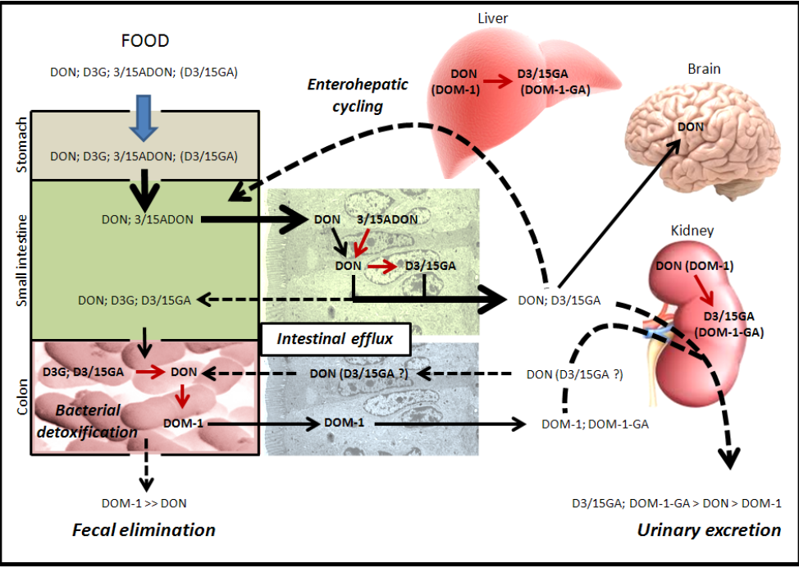
Overview on the Transports and Fates of DON in human body
Two major Metabolites (DON-3G & DON-15G)

Slide 6
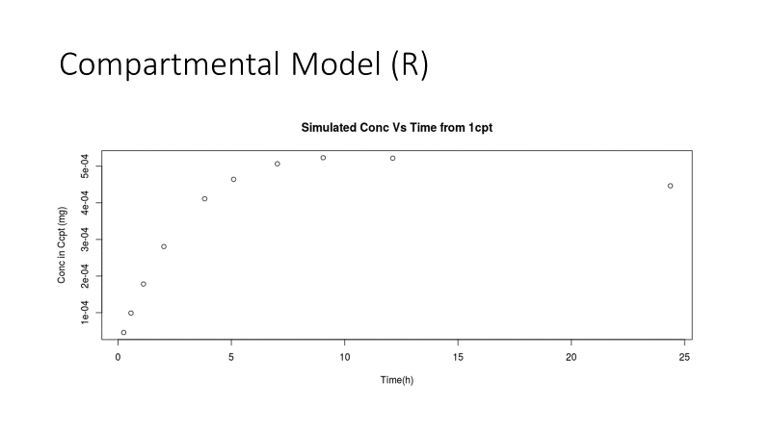
Developed a one compartmental model of DON
Prepared and compiled the model file
Prepared and compiled the input file
Executed and plot the model predictions

Slide 7
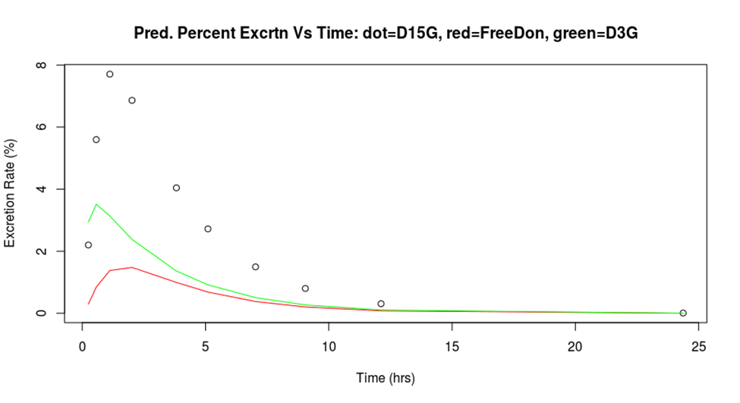
Developed an extended one compartmental model of DON
Prepared and compiled the model file
Prepared and compiled the input file
Executed and plot the model predictions

Slide 8
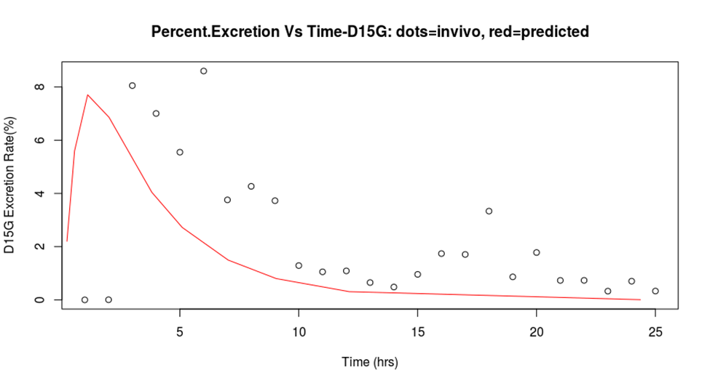
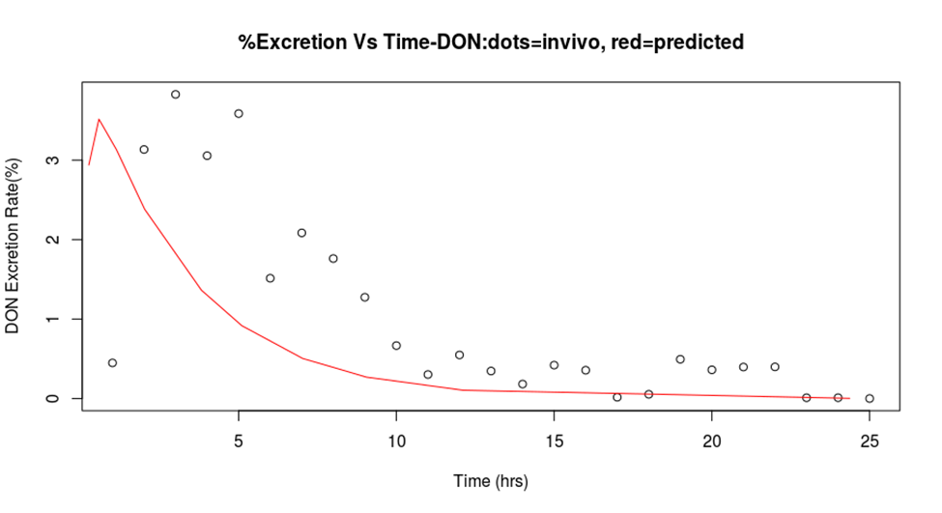
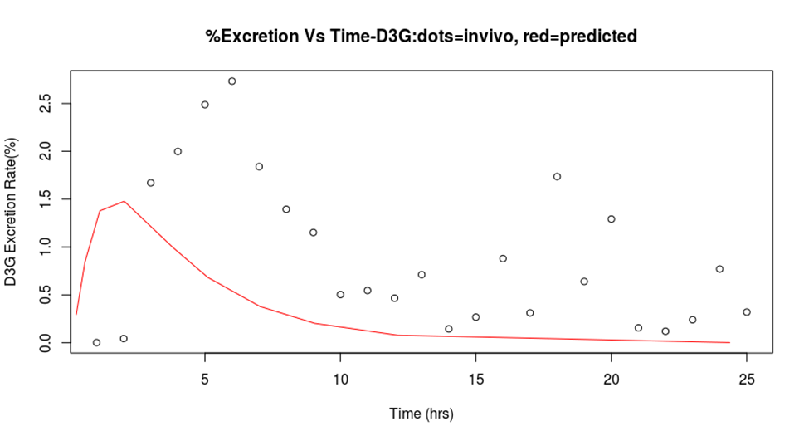
A comparison between original experimental data and predicted percent excretion recovered compound in urine

Slide 9
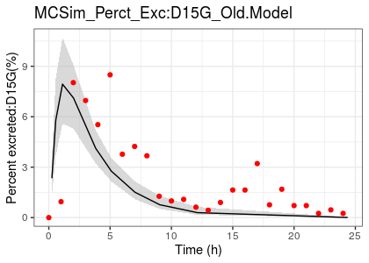
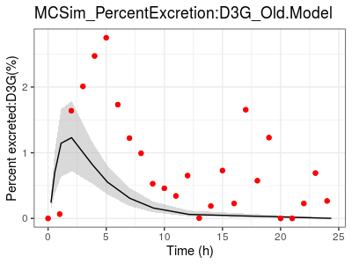
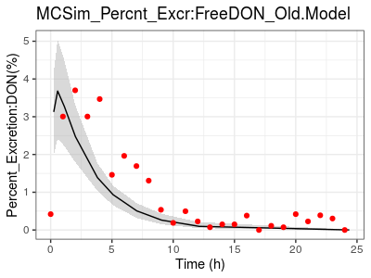
Monte Carlo Simulation of Model performance without Gut, Gallbladder and Fecal compartments: Prediction (black) and in vivo experimental (Red)

Slide 10
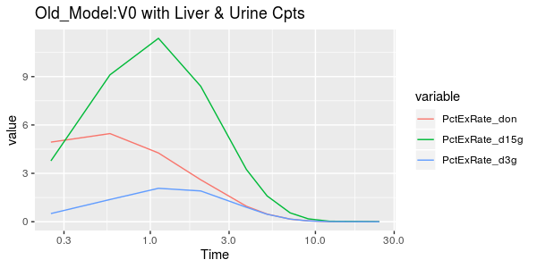
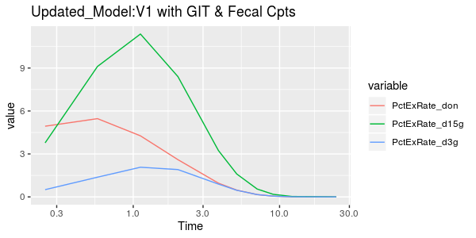
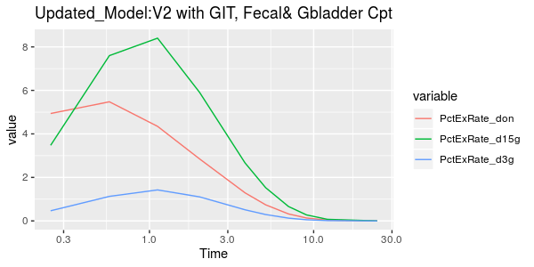
Incorporating Gut, Gallbladder and Fecal compartments into the model

Slide 11
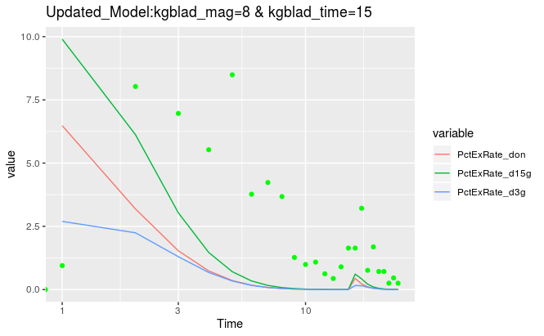
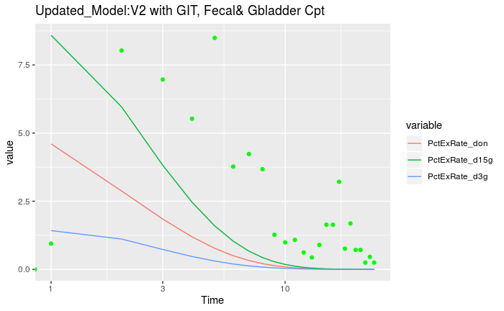
Updated Model_ with the kgblad as an Input that is 0 most of the time except for for a short time (e.g., 1 hour)

Slide 12
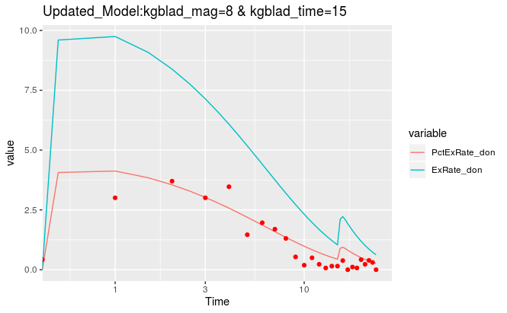
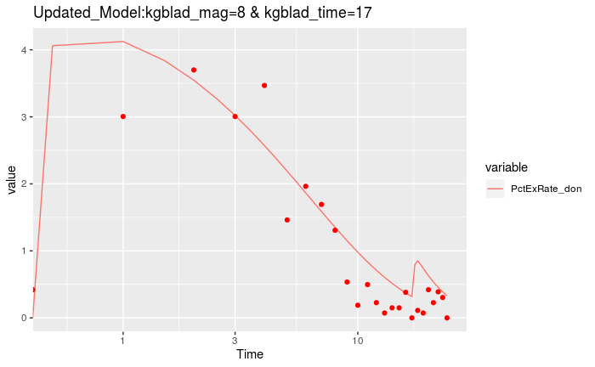
Model Simulations

Slide 13
Learning benefits
Learned some basic r programming skills
Learned how importance it is to separate human and animal data in literature review
Learned some basic programming skills
Learned how to write model equations for PK modeling
Learned how to abstract PK data from published studies
Learned how to build one compartmental pk model
Learned how to extend one compartmental model to account for liver and kidney kinetics
Applications of research in public health decision from other presentations
How to digitize plots from published studies and use the digitized data for model validation
How to incorporate Gut and Gall Bladder compartments to an extended model
Learned how to compare model predictions with experimental data
Learned how to do some Monte Carlo Simulations and analyze the outputs
Learned how a lab holds progress meetings

Slide 14
ACKNOWLEDGEMENT
Preceptor: Dr. Chiu, Weihsueh Professor
Practicum Coordinator: Dr. Han, Dikwan
All Professor Chiu’s lab members

Slide 15
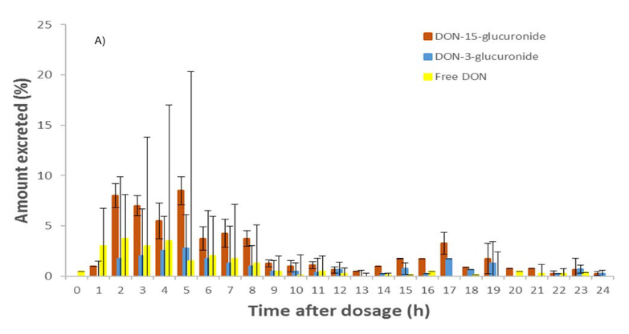
In vivo urine data: Average sum and SD of DON-15-GlAc and DON-3-GlAc (%)

